Slide 1


Our Journey: Exploring Asset & Market Indicator Relationships
Ali Mirza Ammar
Notes:
Salam,
I would walk you through the journey of me trying to uncover relationships between asset prices and market indicators. This might give you a different perspective of looking at the markets

Slide 2

The Issue
Simple truth? Financial markets are highly uncertain. This uncertainty creates major problems for anyone trying to invest, plan, or manage their money effectively.
2
Notes:
Why bother?
Financial markets are uncertain, especially when the bigger picture changes. That makes it hard for everyone trying to invest or trade, both at divisional and corporate levels.

Slide 3

The Goal
To hunt for relationships between asset price movement and other financial indicators.
3
Notes:
So, the aim is to find a pattern or a relationship between assets and indicators that makes people times in the market easier.

Slide 4
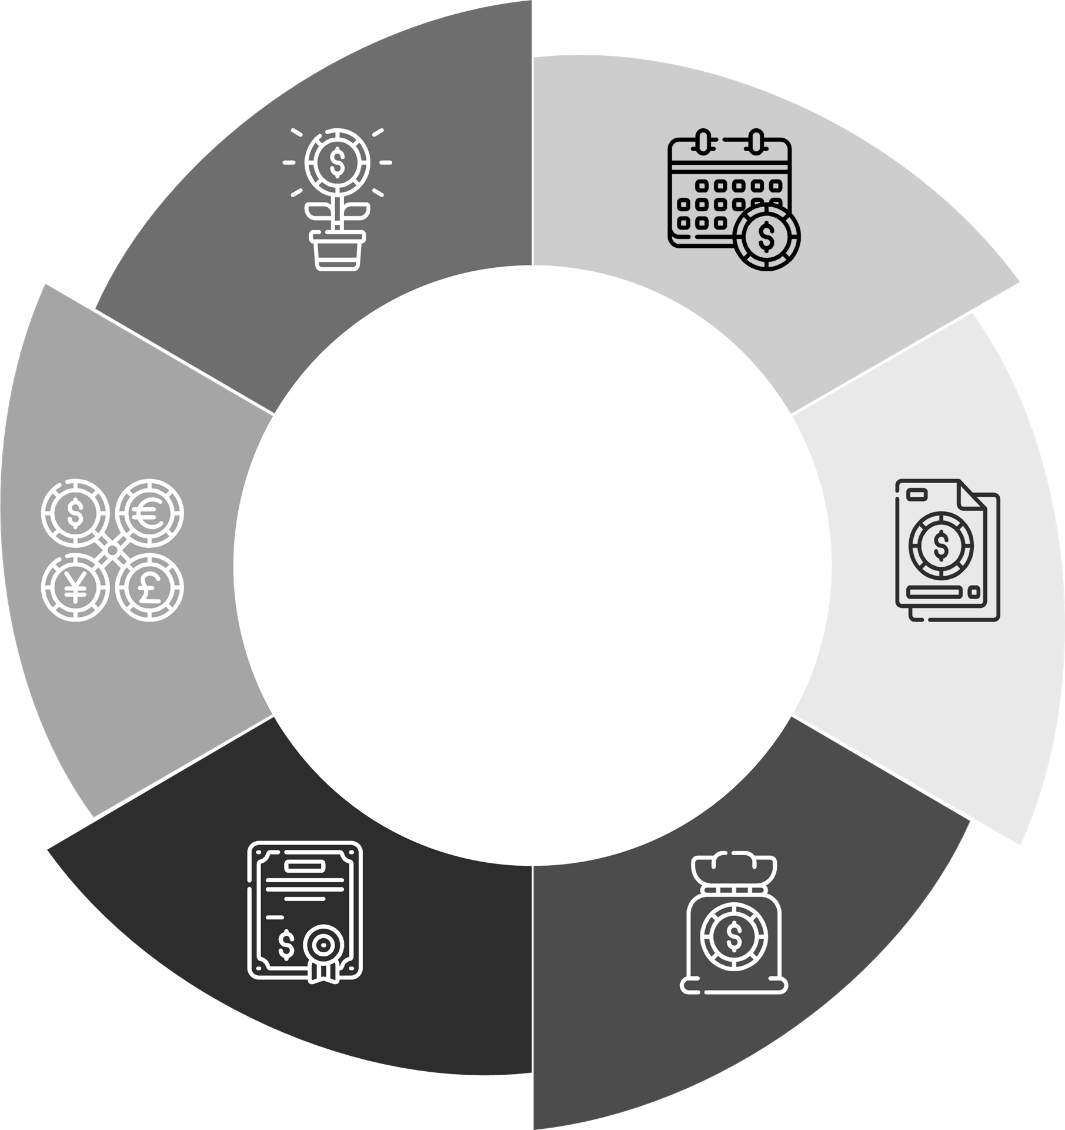
How? Data Of Course
Time
Period: Jan 2015 – May 2024
Frame: Monthly
Sources
FRED ‘Federal Reserve Economic Data’
Kaggle
Assets
SPY (S&P 500 ETF)
OIL (Crude Oil)
XAU (Gold)
Size
Period> 75 years
Features: 43 Indicators/Assets
Indicators
VIX (CBOE Volatility Index)
DXY (US Dollar Index)
4
Notes:
But how? Using data of course!
I gathered more than 75 years worth of data with 43 features (both asset prices and other indicators) from FRED and Kaggle.
The data is huge, that is why I only focused on 10 year between January 2015 – May 2024 and I considered monthly Time Frame.
I also focused on only three Assets (SPY, OIL, XAU) and two indicators (VIX, DXY).

Slide 5
SPY vs VIX
Notes:
The first of three pairs that looked promising is SPY vs VIX.

Slide 6
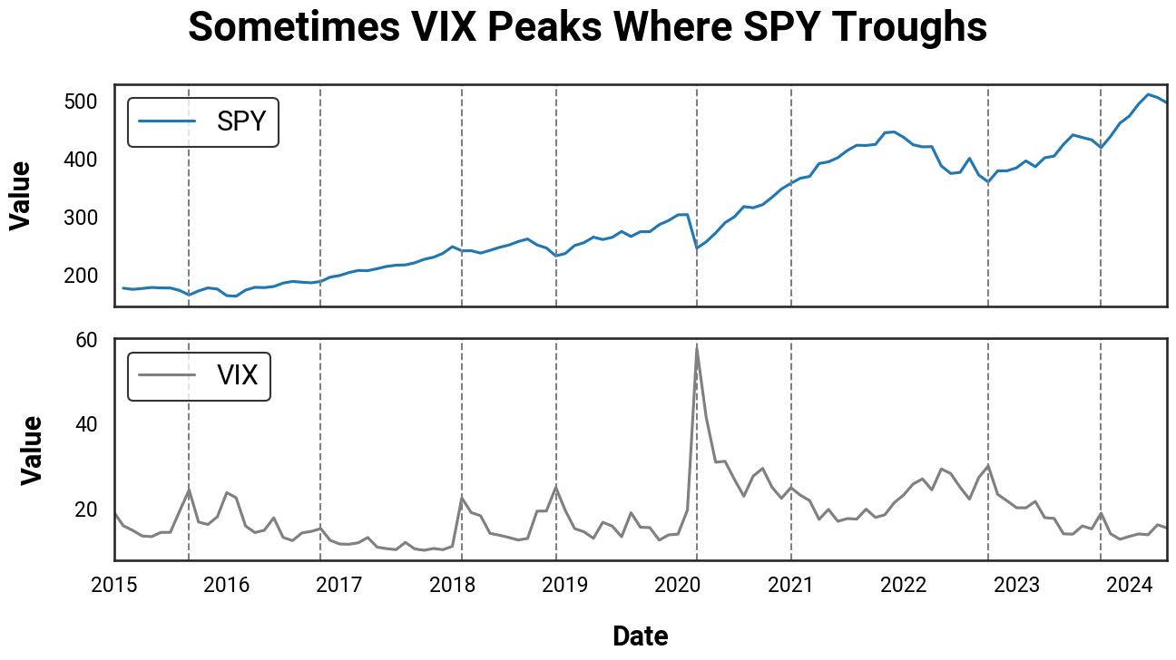
6
Notes:
This is to have a look at the time evolution of the pairs. The grey dashed lines are some random (not all) times where the volatility index peaks. Often, when the volatility index peaks, the SPY decreases.
To better compare the two pairs, we would consider the Month to Month change in percentage of them instead of their actual values from now on.

Slide 7
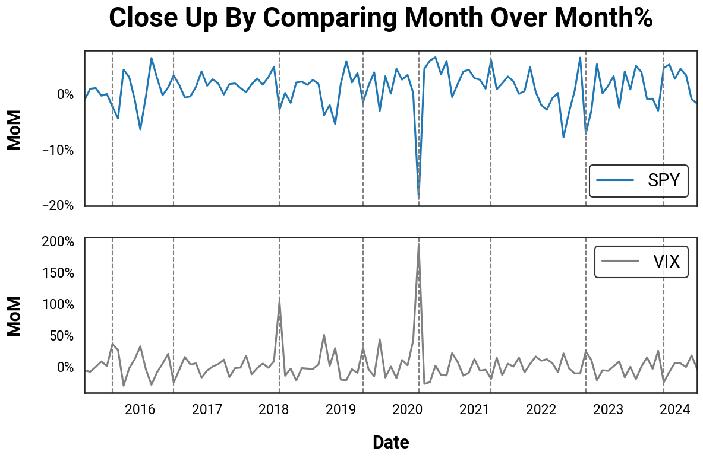
7
Notes:
This is the same graph as before but in MoM%. You can see the same behaviors better.
What I am going to do would might not make sense at first, but bare with me.
For each month, I would take the SPY and VIX MoM% and make a scatter plot with the pair.

Slide 8
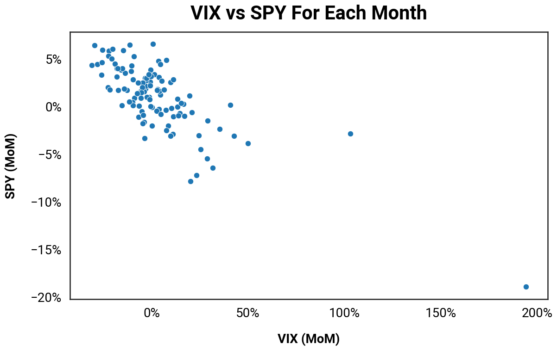
8
Notes:
Just a bunch of random points, right?
Lets zoom in to this cluster and put the x and y axis. There where things gets interesting.

Slide 9
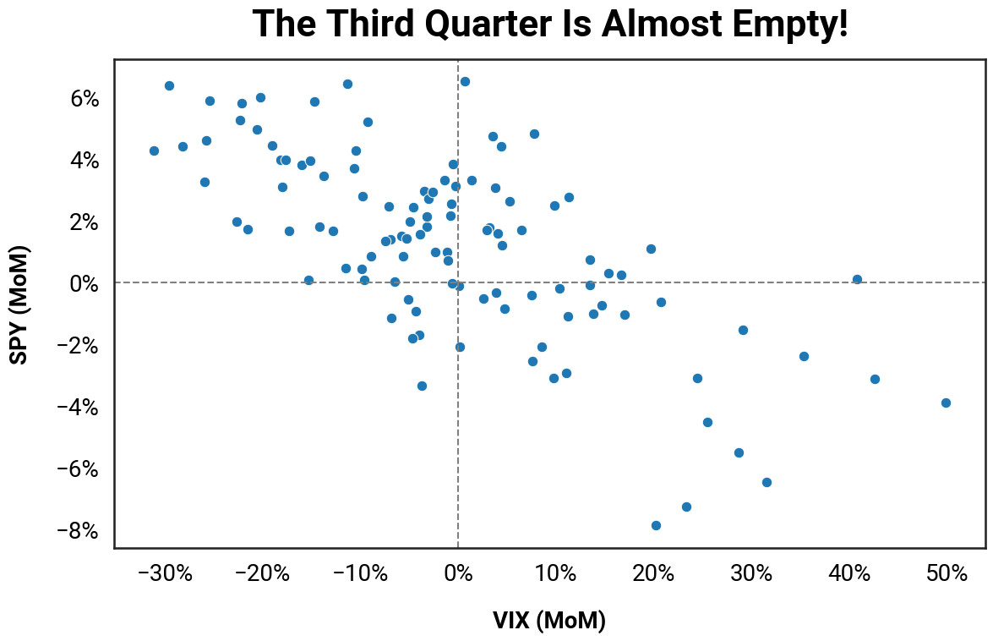
9
Notes:
For some reason, the third quarter is empty!
What does it tell us? It says when volatility index decreases, more often SPY increases than decreases. How often?

Slide 10
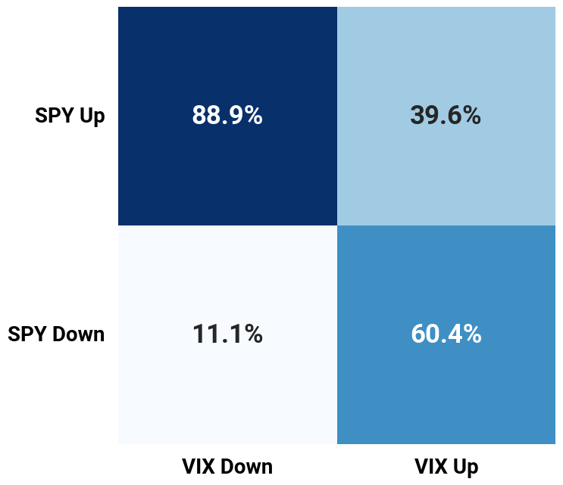
Probability Game?
10
Notes:
Almost 90% of the times when volatility index decreases, the S&P 500 increases!
Also, 60% of the times when the volatility index increases, the S&P 500 decreases!
It seems it is a probability game after all ?

Slide 11
OIL vs VIX
Notes:
The second pair is crude oil vs volatility index. I have done the same analysis as before, but we’re gonna jump straight to the last bit instead.

Slide 12
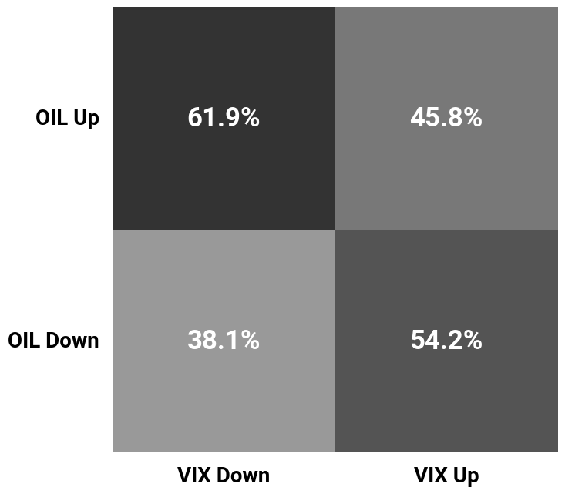
Less Clear
12
Notes:
Same pattern here, but less clear.
62% of the times when Volatility decreases, oil increases.
But it is not promising for the times when volatility incre1ases

Slide 13
XAU vs DXY
Notes:
The third pair is GOLD vs US dollar index. Same story.

Slide 14
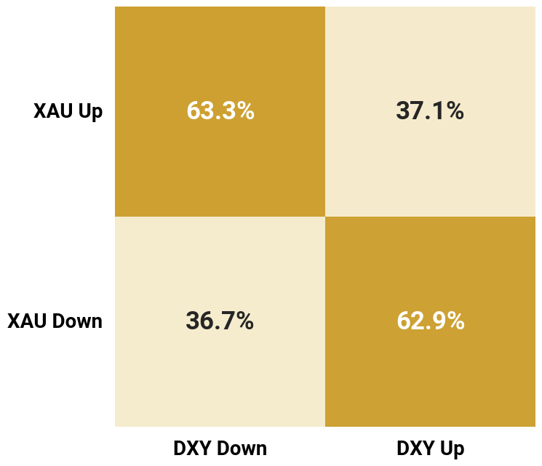
Inverse Relationship?
14
Notes:
More consistent inverse relationship between the XAU and DXY.
Its more probable to see gold increases when DXY decreases. Also, it is more probable to see gold decreases when DXY index increases.

Slide 15


Summing Up
VIX↓ = SPY ↑
Very Likely 89%
VIX↓ = OIL ↑
Less Likely 62%
DXY↓ = XAU↑
DXY↑ = XAU↓
Less Likely 63%
15
Notes:
To sum up, these are the most notable findings:
Its very likely with 89% chance to for the SPY to increase when volatility in the markets decreases.
Same pattern for OIL, but less likely with 62% chance
For gold, the chances suggests that there might be an inverse relationship between XAU an DXY. As 63% of the times when the DXY decreases, XAU increases. And the vice versa
As that conclusive and you need to base your investment strategies on? Not so fast,

Slide 16

Limitations
Period
Assets
Only 10 years worth of data
Only three assets considered
Frequency
Indicators
Miss intra-month movement
Only two indicators considered
Lagging
Market Regime
Potential lagging not considered
The bigger picture?
This analysis is for educational purposes only and is not investment advice. It's a step towards understanding market relationships, not an investment strategy.
16
Notes:
There are limitations to point out:
1- only 10 years are analyzed.
2- monthly frequence misses movements that happens in between.
3- There could be a lagging effect that I did not consider.
4- There are more pairs than I considered
5- The bigger picture of the economy might have an effect

Slide 17
Last Word
Take Aways
Better SPY Performance With Certainty
Probabilistic Sense
Further Investigate
Other Assets/Indicators
Lagging Phenomena
Different Frequency
17
Notes:
Last word before I end my presentation, if there’s one thing you take away, remember these two things: SPY does better when VIX decreases, Markets should be dealt with probabilities not certainties. And before you implement what I discussed today, you should first investigate other assets and indicators, check for lagging phenomena, and see different frequencies.

Slide 18
The End

